Slide 1


DECRYPT
AUDIT
08.10.2024
Qods ABIDI
Loann KAIKA
Clément SARAZIN

Slide 2
Sommaire
Project presentation
Use cases
Specifications
Corporate social responsibility
Planning
Conclusion

Slide 3
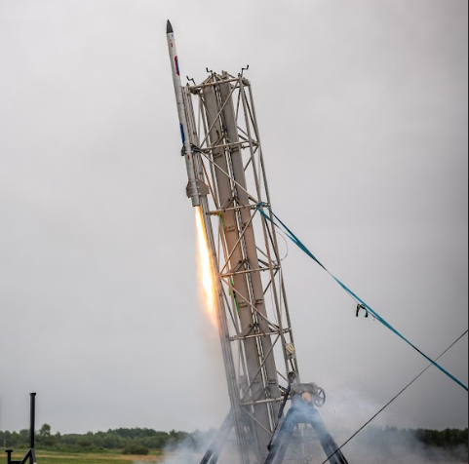
Introduction
moDular and Embedded platform for Control and telemetRY of aerosPace sysTem

Slide 4
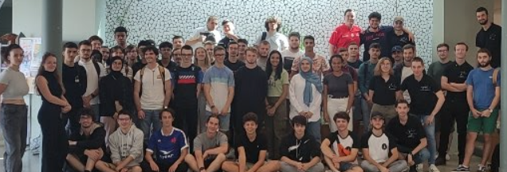
Project presentation
I.1) Space’Tech Orléans
Student association
70 members
TEAM, GPSE , ICM, PEIP
Rocket design -> minif, fusex
C’Space

Slide 5
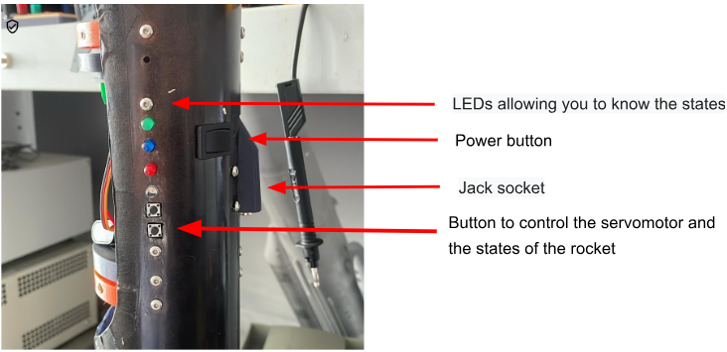
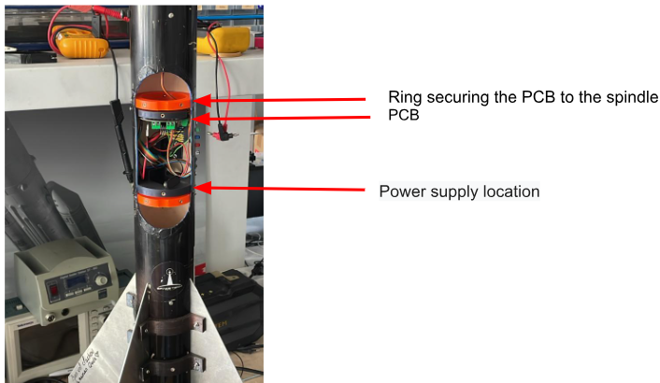
Project presentation
I.2) Our goals
Realization of on-board electronics
Accessible to everyone
Adaptable to all rockets
Diagram of electronics in the rockets, Qods ABIDI

Slide 6
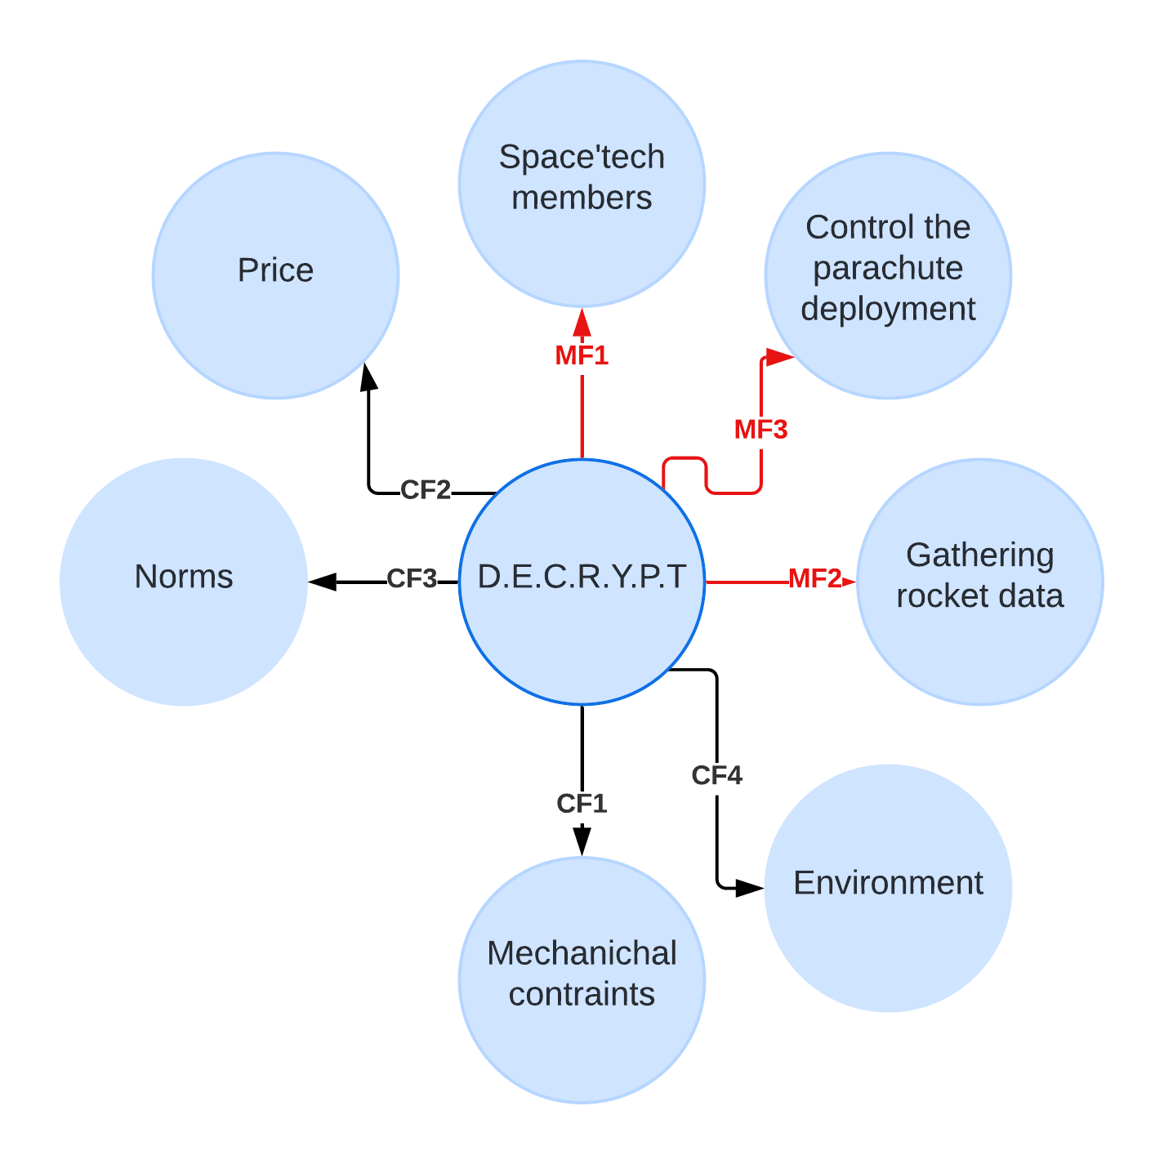
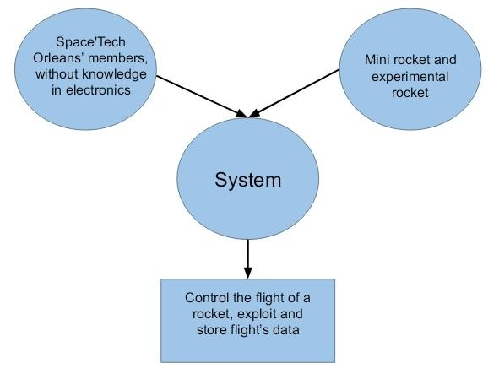
II. Use cases
II.1) Functional analysis
horned beast , Qods ABIDI
Octopus diagram, Clément SARAZIN

Slide 7
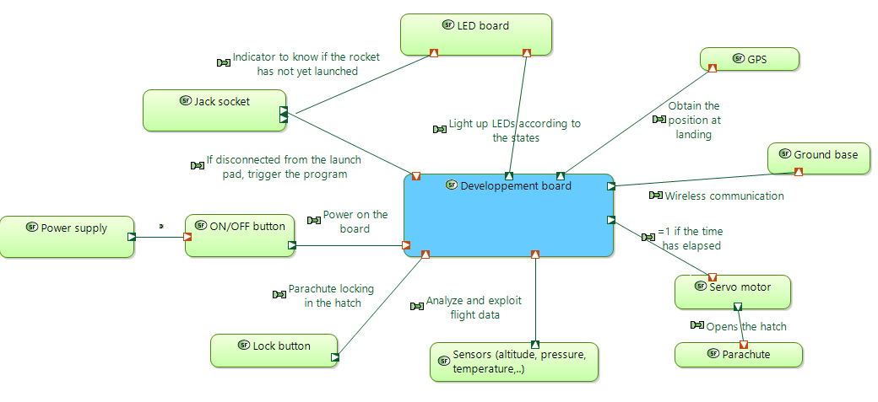
II. Use cases
II.2) The expectations of our system
Use case diagram, Loann KAIKA & Qods ABIDI

Slide 8
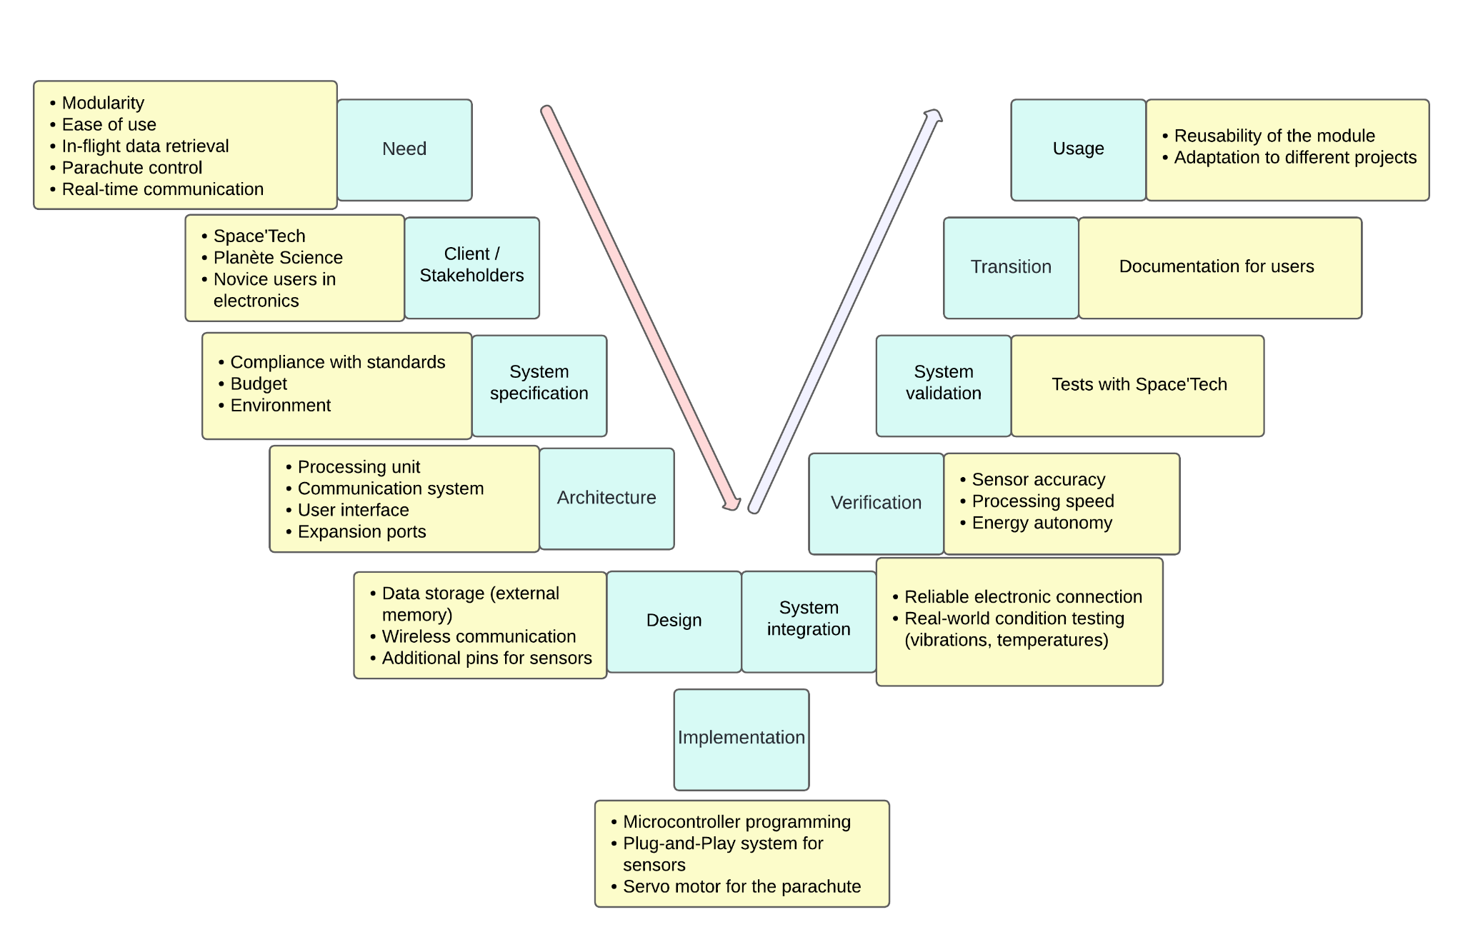
II. Use cases
II.3) Functional architecture
V diagram, Loann KAIKA

Slide 9
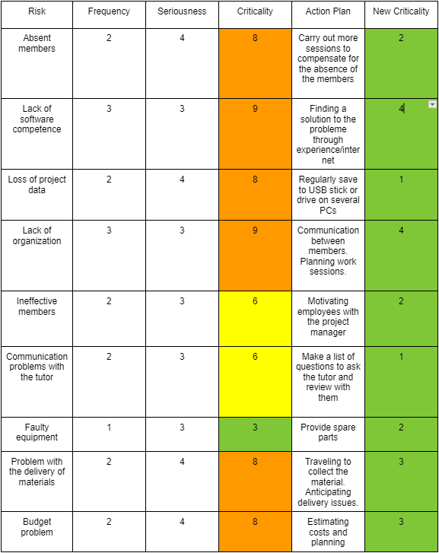
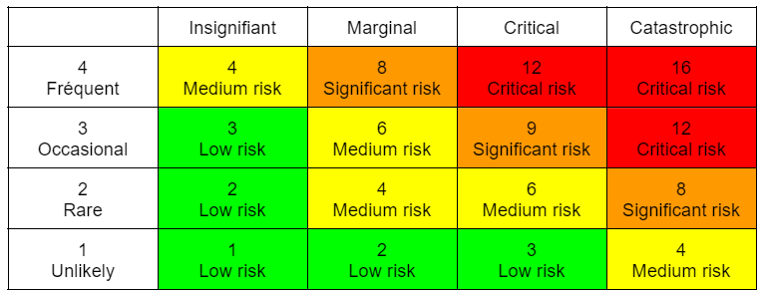
II. Use cases
II.4) Threats
Risk matrix, Clément SARAZIN

Slide 10
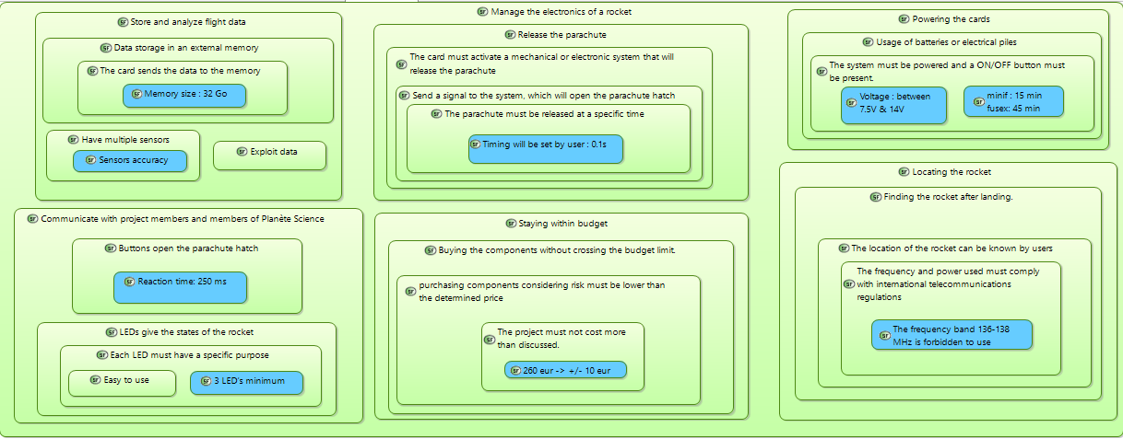
III. Specifications
Specifications diagram, Qods ABIDI

Slide 11
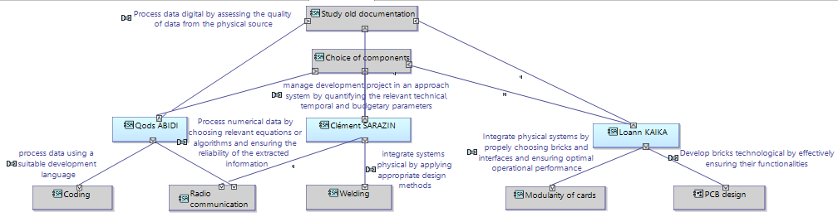
IV. Planning
IV.I) Distribution of roles
Diagram of roles distribution, Qods ABIDI

Slide 12
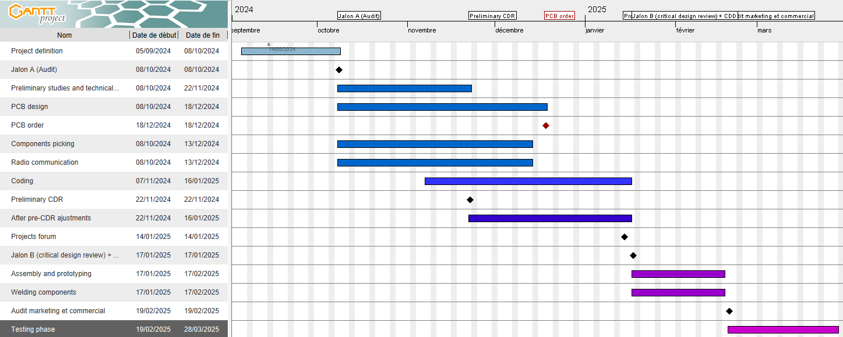
IV. Planning
IV.2) Time Planning
Diagram Gantt, Clément SARAZIN

Slide 13
IV. Planning
IV.3) Budget planning
PCB | Sensors | Power | Components | Radio Communication | Storage
30 € | 40 € | 70 € | 50 € | 50 € | 20 €
Total : 260 €
Budget planning, Qods ABIDI

Slide 14
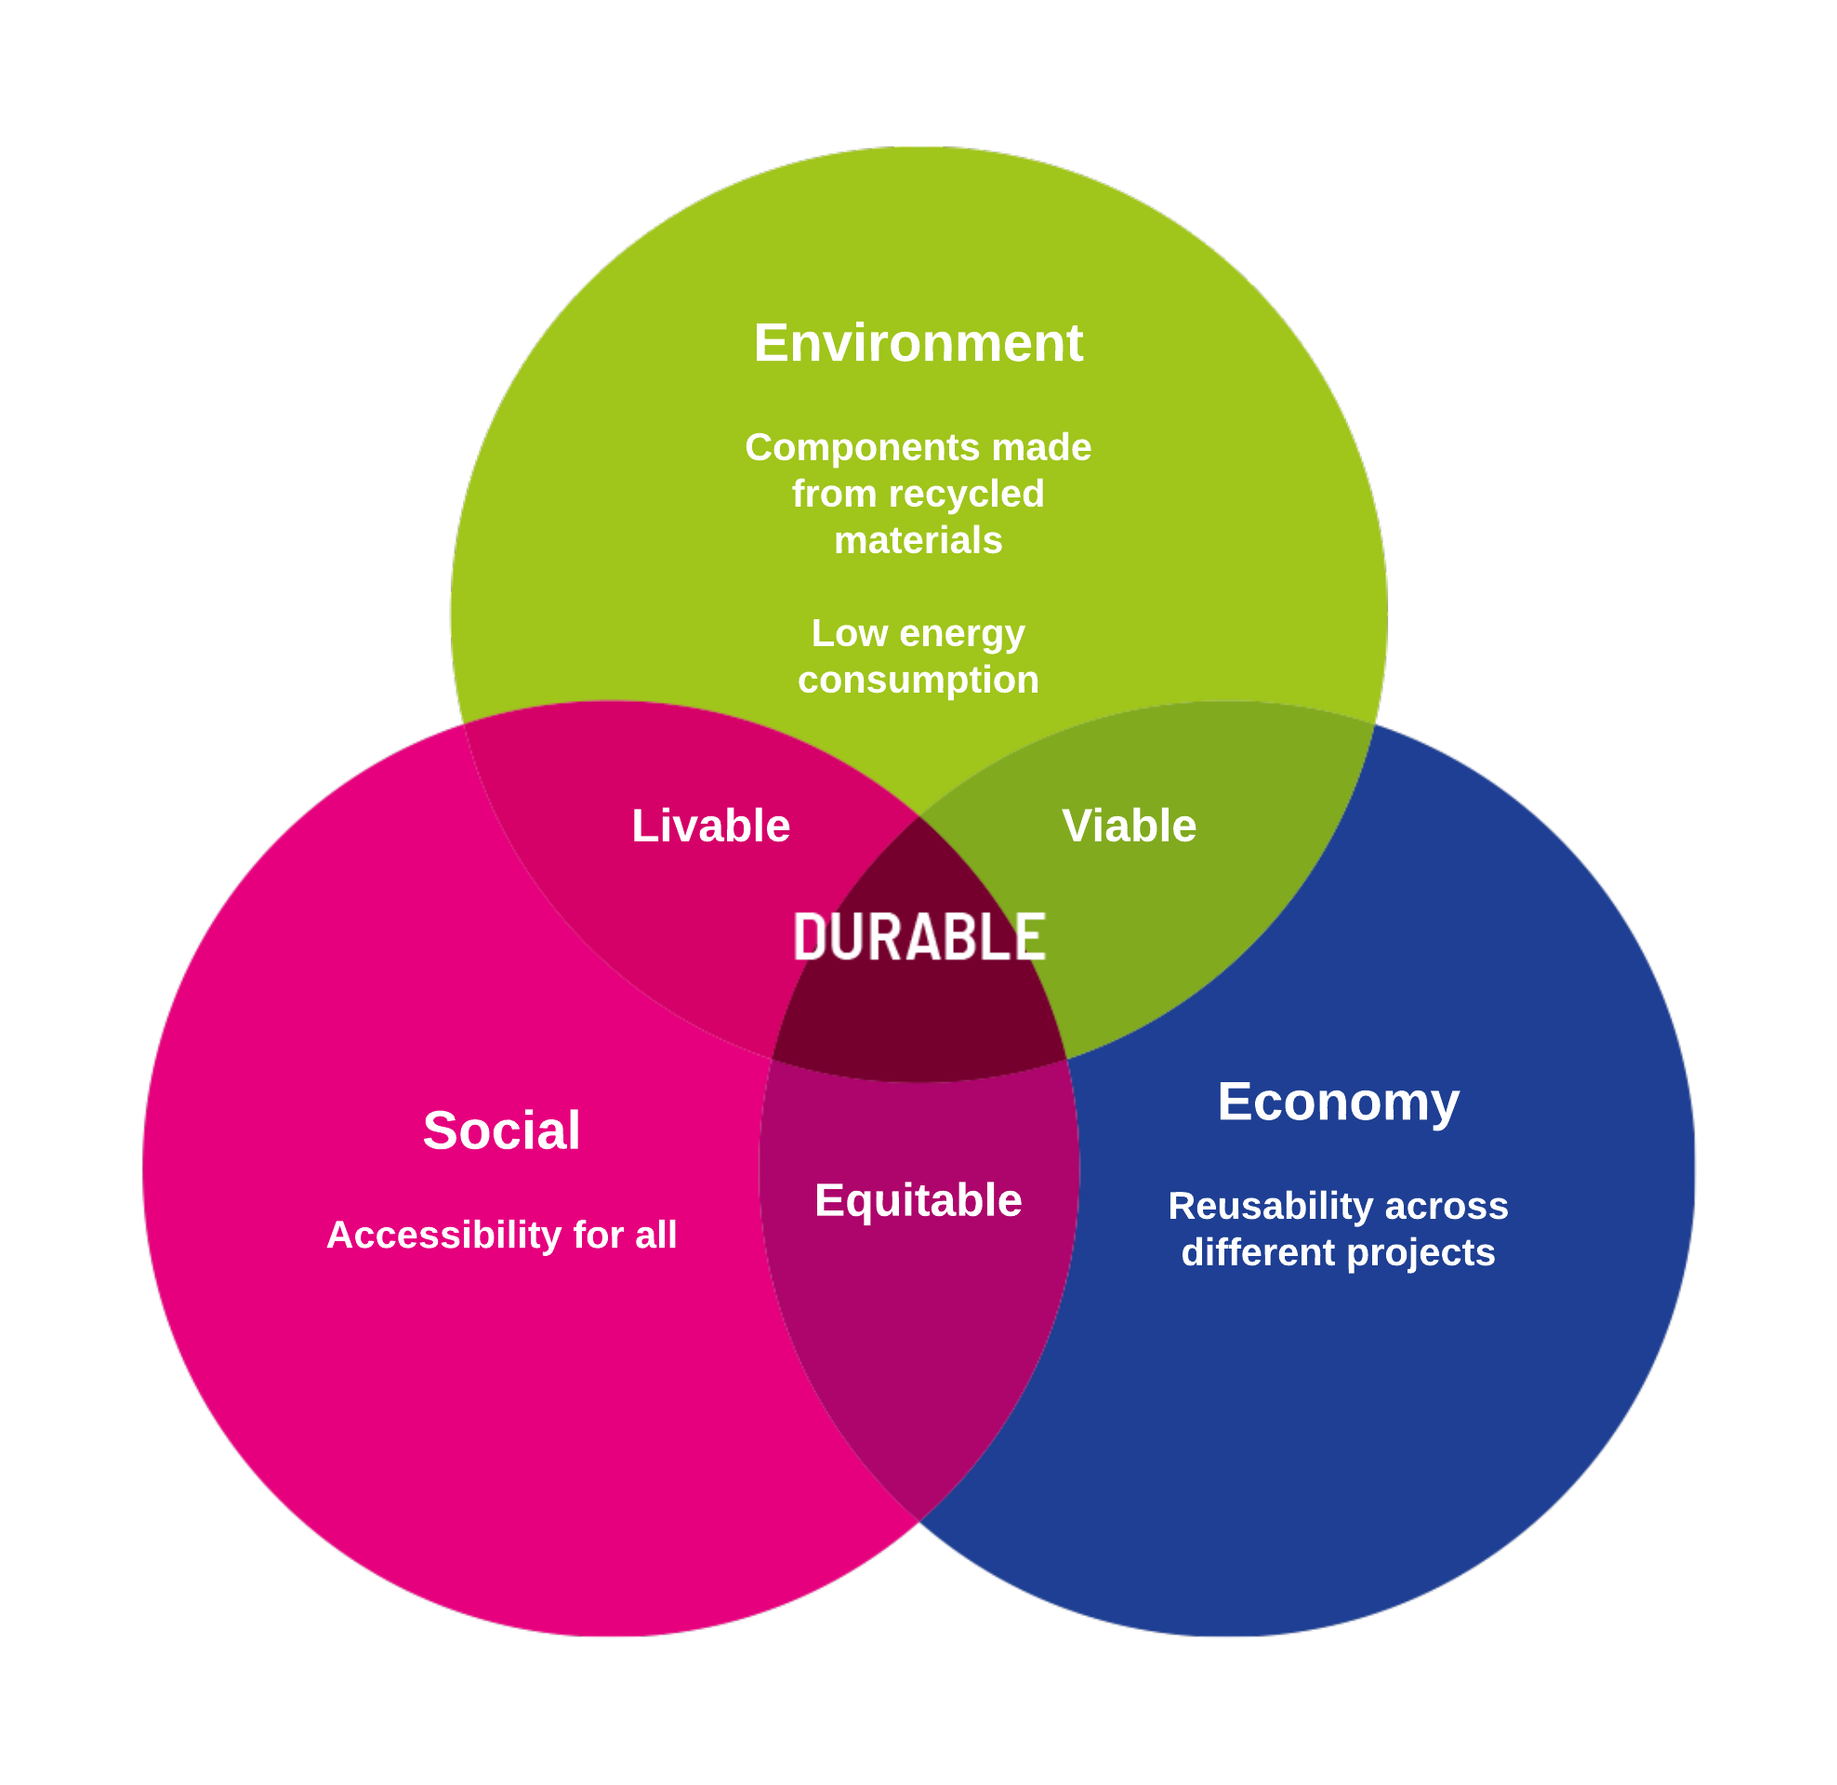
V. Corporate Social Responsibility
Sustainability Triangle RSE
RSE diagram, Loann KAIKA

Slide 15
Conclusion

